Slide 1

Web-technologies (cse-2067) miniproject
---------------A static webpage on the topic ---------
-------------------------------“awareness”--------------------

Slide 2
Department of Computer Science and Engineering School of Engineering Section : 3CSE9 Submitted by:
Name | Roll number
K.Laya sree | 20211CSE0375
Tejeswini L | 20211CSE0356
Ramya Sataraddi | 20211CSE370

Slide 3
abstract
Our mini-project: ”A static webpage on awareness” is created using various programming languages as XHTML,CSS,PHP . Our project aims on spreading awareness about campaigns that are unaware by most of the people in the world i.e. the zero-hunger campaign, hosted by UNO, stray-dogs protection, hosted by VOSD(voice of stray dogs),and global warming The home page consists the main reason for awareness. The header of this webpage contains animation and when we click them it leads to various webpages We also created a registration form to encourage people to register themselves into various campaigns listed above . On the journey of creating this webpage we learnt many things as in how to create a webpage and how to use css(styling) and make our webpage attractive

Slide 4
Hardware and software requirements
Hardware | Software
Laptop: Processor Intel(R) Core(TM) i5-10210U CPU @ 1.60GHz 2.11 GHz RAM 4.00 GB or above System type: 64-bit operating system, x64-based processor | Notepad Web-browser Xampp Mysql

Slide 5
Project module
Name of the module | Description
HOME.HTML | Displays the home page of our website
FRAMES.HTML | Divides the webpage into 2 frames:top and bottom
ZERO-HUNGER CAMPAIGN.HTML | Displays information about zero-hunger campaign
STRAY DOGS PROTECTION.HTML | Displays information about straydogs protection
GLOBAL WARMING.HTML | Displays information about global warming
REGISTER.HTML | Displays registration form to signup under any campaigns

Slide 6
ABOUT
Why awareness!?
We’re more likely to care for our planet if we pay attention to it. Awareness builds a sense of connection to the earth. We become stewards of a healthy future.
There are many awareness that are unknown to us…
Few of them are:Stray dogs protection ,zero-hunger campaign & global warming(common)
Global warming:
Global warming is a gradual, long-term increase in the average temperature of Earth's atmosphere due to the greenhouse effect where gasses from various human activities, including the burning of fossil fuels, trap heat from solar radiation.

Slide 7
Stray dogs protection campaign:
hosted by VOSD(voice of stray dogs)
Very often, you find yourself stepping out of your home and being surrounded by stray dogs. Some of them look quite healthy while the others look hurt, famished, or weak. Some of them even display signs of diseases. This campaign helps them to find a new home for the dogs
Zero hunger campaign:
Hosted by UNO(united nations and organisations)
The Zero Hunger Challenge was launched to drive commitment and action by all stakeholders, including business, to end malnutrition in all its forms and realize inclusive, resilient and sustainable food systems

Slide 8
OUTPUT

Slide 9
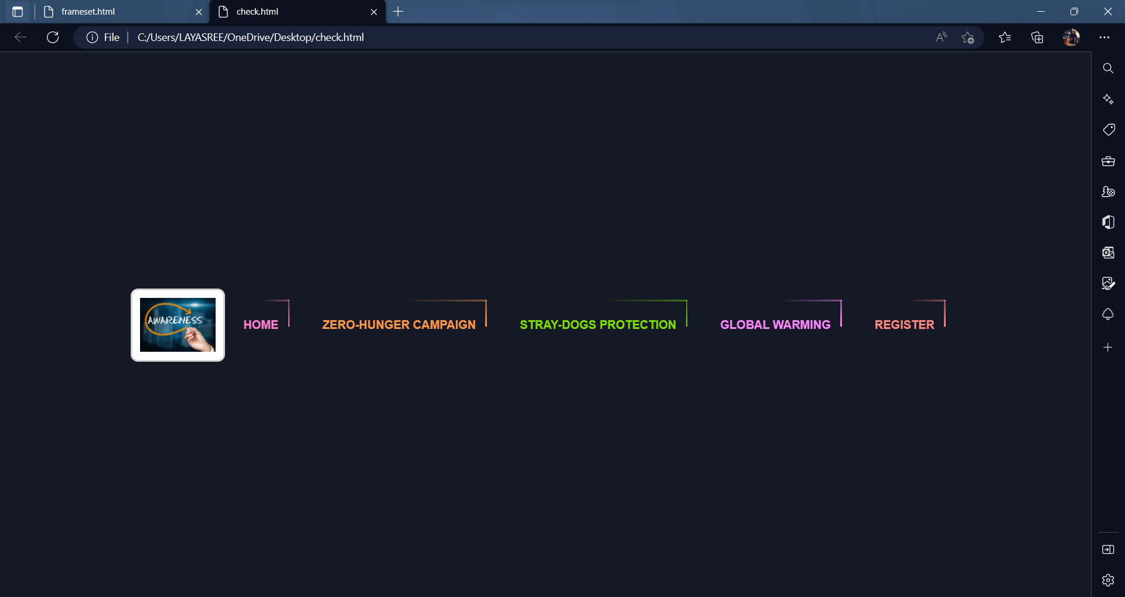

Slide 10
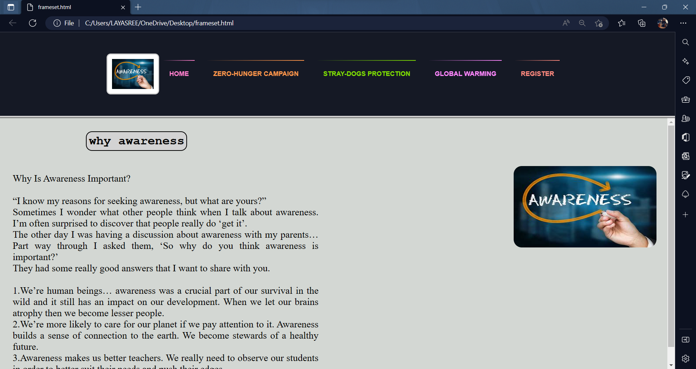

Slide 11
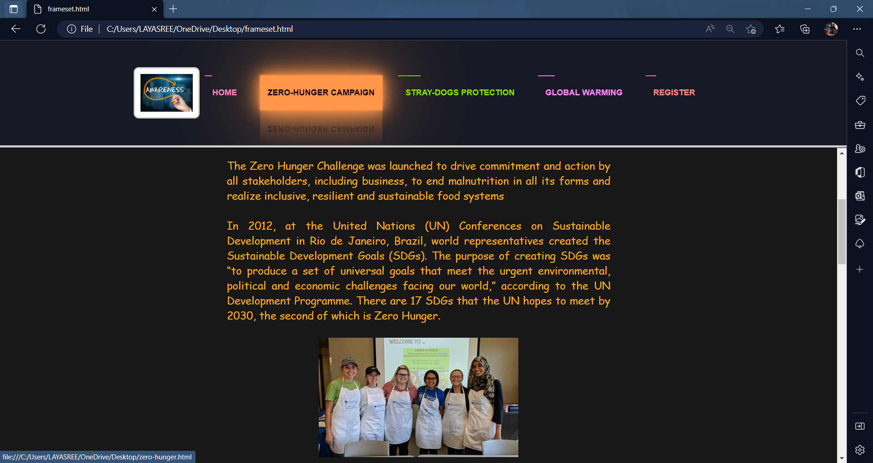

Slide 12
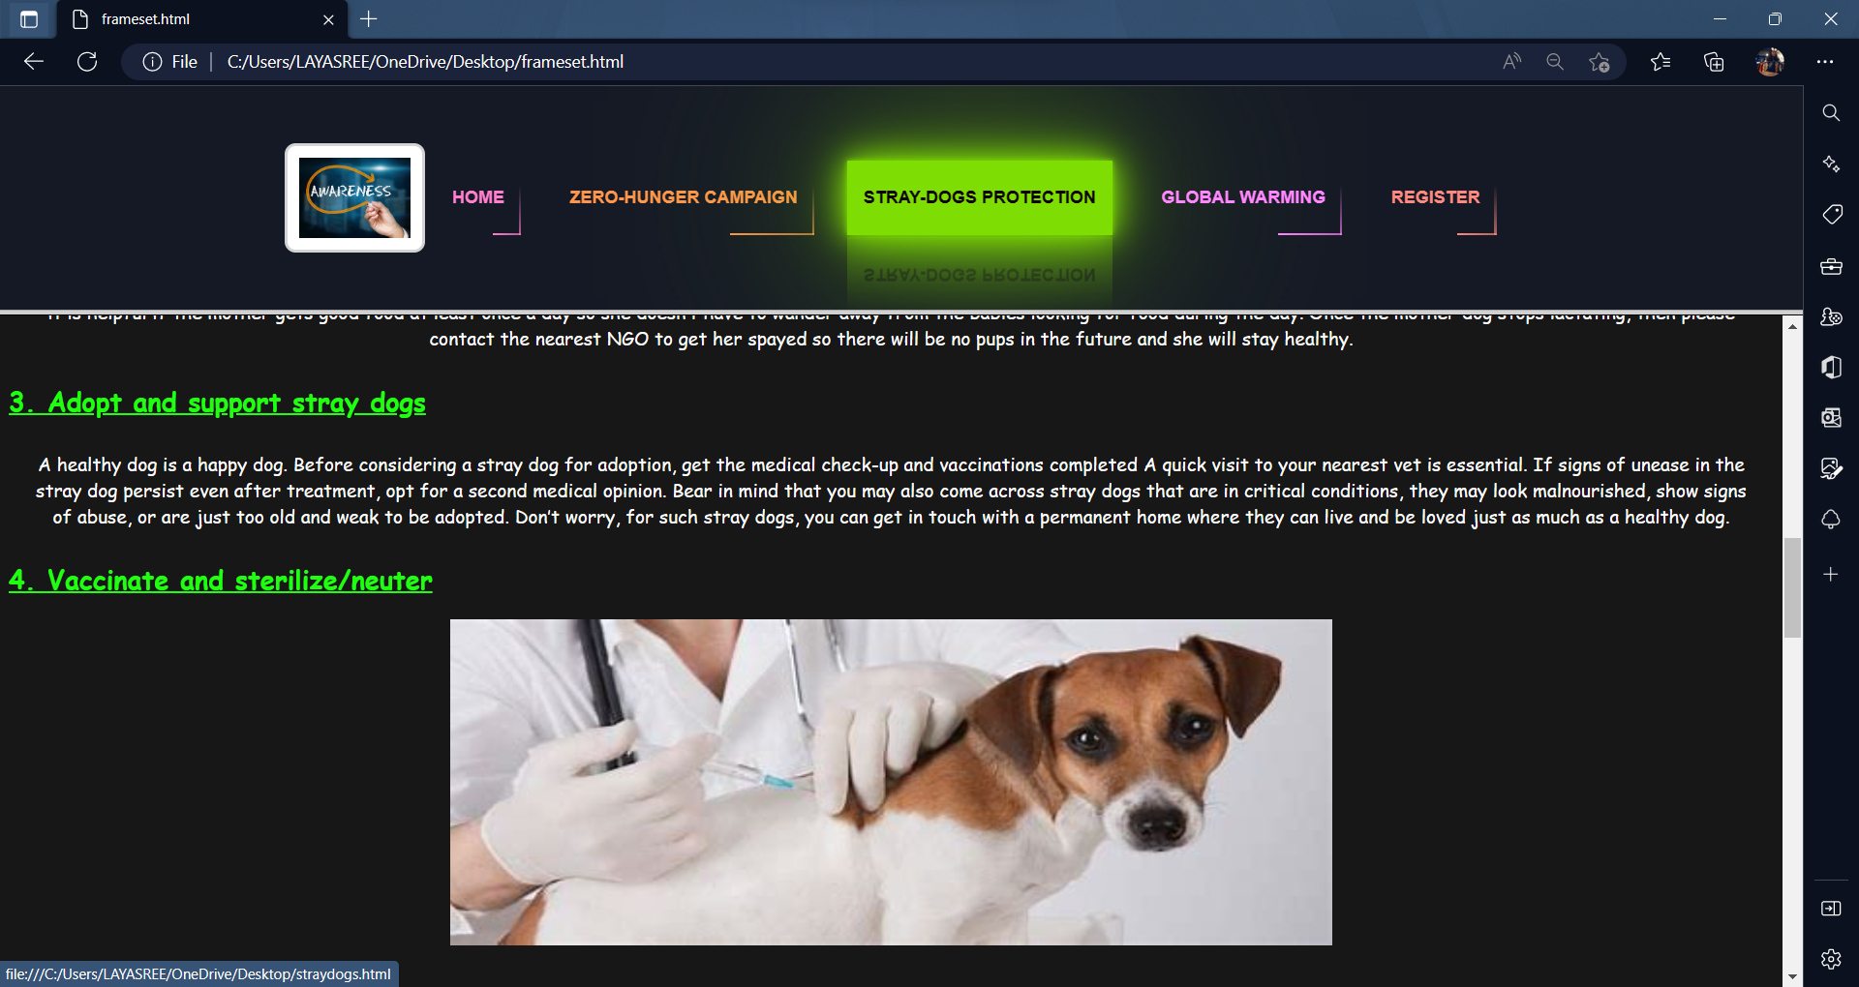

Slide 13
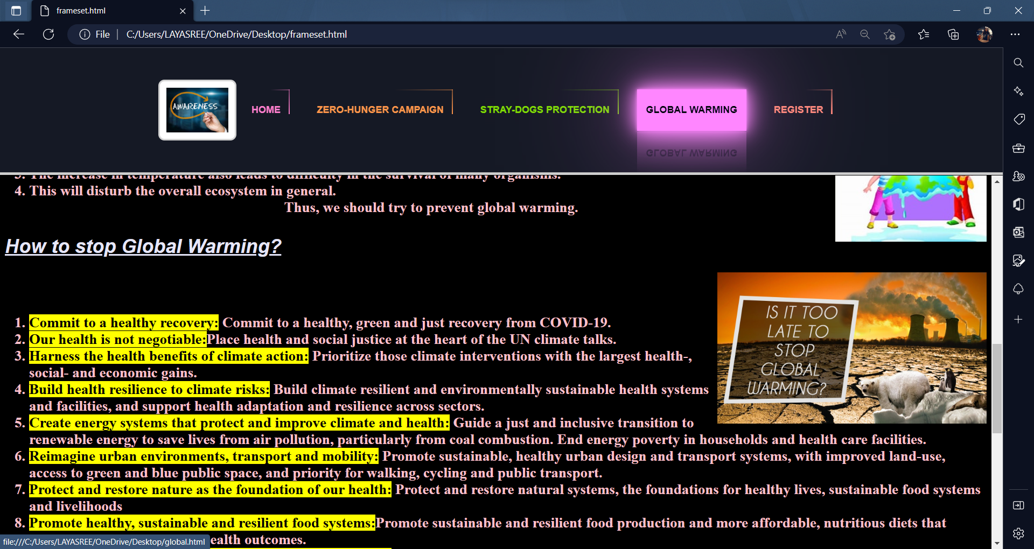

Slide 14
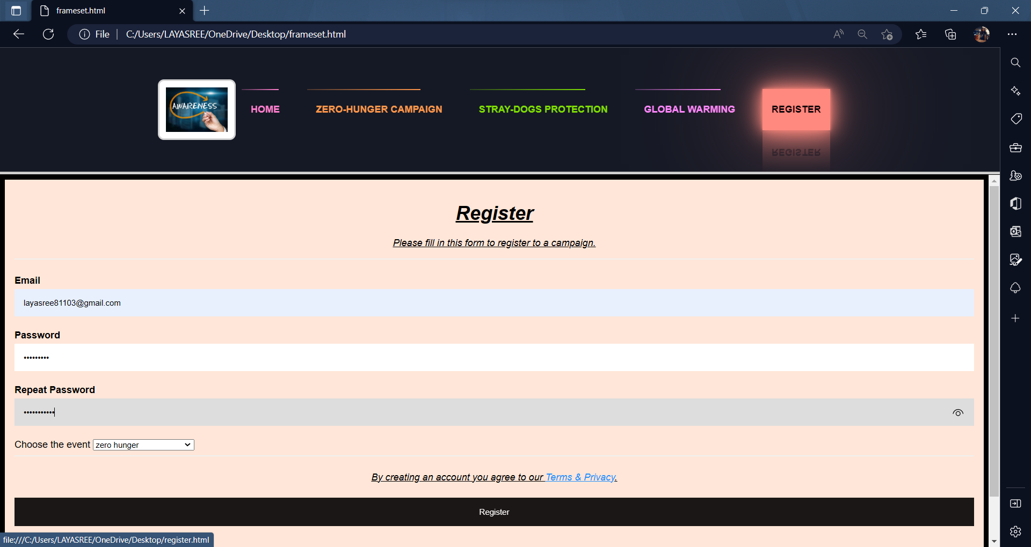

Slide 15
THANK TOU!!

